Slide 1

MODULE 5- SYSTEM ADMINISTRATION
I- USER ACCOUNT MANAGEMENT
II- ELEVATING USERS ROLES
III- MONITOR USERS ACTIVITY
IV- SYSTEM UTILITIES UNDER ACCESSORIES
V- PROGRAMS AND SERVICES MANAGEMENT
VI- SYSTEM RESSOURCES MONITORING
VII- WINDOWS EVENTS LOGS
VIII- JOBS AND SCHEDULES
IX- SYSTEM MAINTENANCE
X- WINDOWS SETTINGS
XI- SERVR MANAGER DASHBOARD
XII- INSTALLING AND UNINSTALLING PROGRAMS
XIII- CHECK SYSTEM HARDWARE
XIV- WINDOWS SHORT-CUT KEYS

Slide 2

I- USER ACCOUNT MANAGEMENT
Every machine needs an user account:
Windows= administrator
Linux= root
There are 2 types of users account that are created on an operating system
The local account ( local account meaning its just yours and it’s not connected to others computers or any other authenticated server)
Directory Service account which allows users to be created at the server level then the user will be log in through that active directory authentication

Slide 3

User Account Management
What we will learn in this lesson:
Add a user account
Remove a user account
Change the display name of the user account
Activate the user account
Deactivate user account
Understand user accounts.
View user accounts

Slide 4

II- Elevating User Roles
Every user in windows has a group
By default a user created without a group will have users group.
We will learn
Give regular users administrative right
Give users access to filesystem

Slide 5
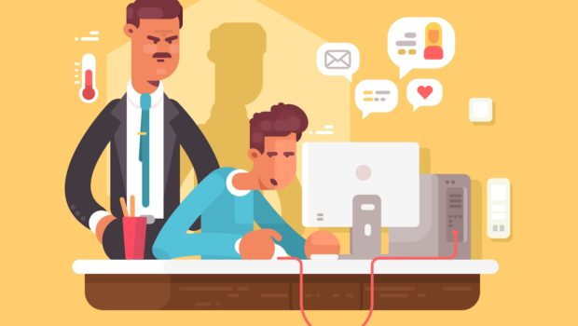
III- MONITOR USERS
It is critical for every system administrator to monitor each user activity
We will learn:
How to monitor users
How to see their activity
Manage their running tasks

Slide 6



IV- SYSTEM UTILITY UNDER ACCESSORIES
We will learn…
Accessing the accessory
Calculator
Browser
Notepad
Paint
Remote Desktop Connection
Spinning tool
Steps Recorder
Windows Media Player
Windows Server Backup
WordPad

Slide 7
V- PROGRAM AND SERVICE MANAGEMENT
Programs or Applications are the main reasons we use computers.
What is…..
Package ? Something that is put together into a file and that file is usually like a tar or zip file you can download it from the internet or copy it somewhere
Application ? Is a computer program designed to carry out a specific task other than one relating to the computer itself, typically to be used by en-users.
Program ? Is a set of instructions that a computer uses to perform a specific function.
Service ? Service is software that performs automated tasks, responds to hardware events, or listens for data requests from other software
Daemon ? Daemon is a process that runs in the background and performs a specific function ... It exists for the purpose of handling periodic service requests that a computer.
Process ? Process is simply a program in execution. One program strictly has one process associated with it.
Threads ? Threads are a way for a program to divide (termed "split") itself into two or more simultaneously (or pseudo-simultaneously) running tasks. ... Threads are lightweight, in terms of the system resources they consume, as compared with processes.

Slide 8
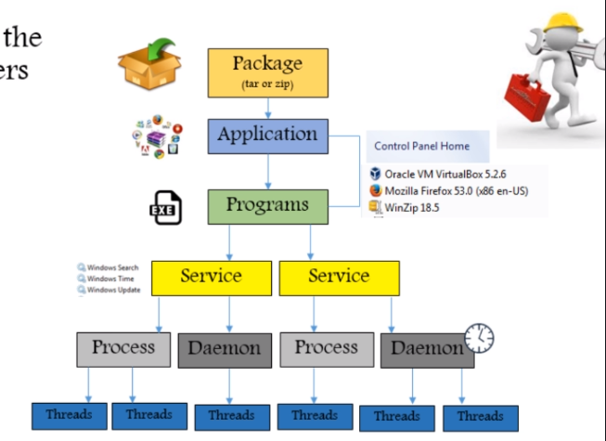
Program and service management

Slide 9


Package ( tar, zip, WinZip)
Download from internet
Programs
Threads
Processes or Daemon
Services

Slide 10
What we will learn
How to install a program/ Application
Delete an application
Package information
Accessing services
Managing services (meaning stop, start, and restart)
Listing processes

Slide 11
VI- SYSTEM RESOURCE MONITORING
What are system resources? Anything that you need your system to run an application
We will learn…
How to access resources monitoring tool.
Identify intensive processes utilizing high resources.
Manage resources

Slide 12
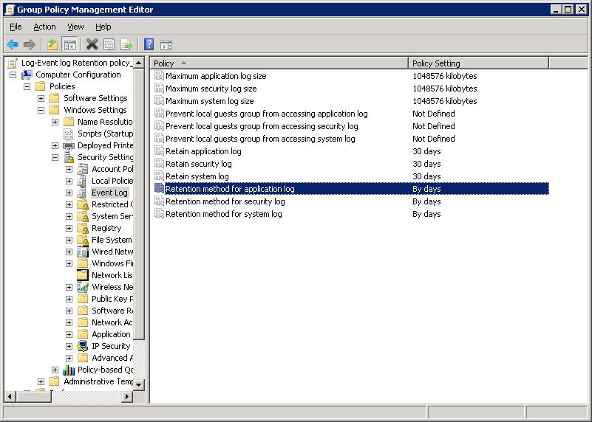
VII- WINDOWS EVENT LOGS
What are logs?
In computing, a log file is a file that records either events that occur in an operating system or other software runs, or messages between different users of a communication software.
types of logs:
Hardware
Operating system ( security, setup, etc.)
Application
Logs location:
C:\Windows\System32\Winevt\Logs

Slide 13
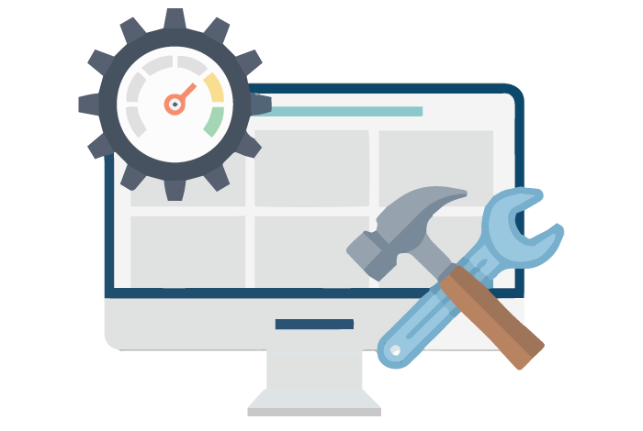
VII- SYSTEM MAINTENANCE
System maintenance tasks includes:
Shutdown
Reboot
Reboot in single user mode (safe Mode)
Windows updates
Patch management (Hotfix)
Disable remote access

Slide 14
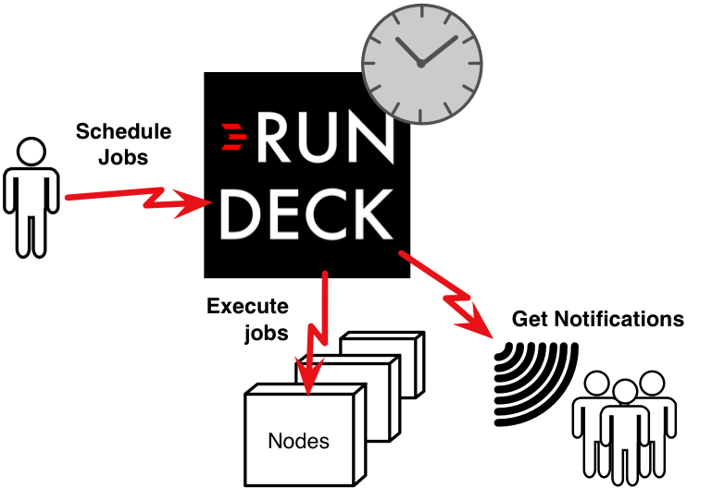
VIII- JOBS AND SCHEDULES
What’s a job?
Job is anything created by a user, administrator or system that perform certain tasks, like create a user, run application, run program, reboot the server.
What is scheduling a job?
We will learn……….
How to create a job (e.g. Reboot the server)
Shutdown /r /t 0
How to schedule that job through task scheduler?

Slide 15
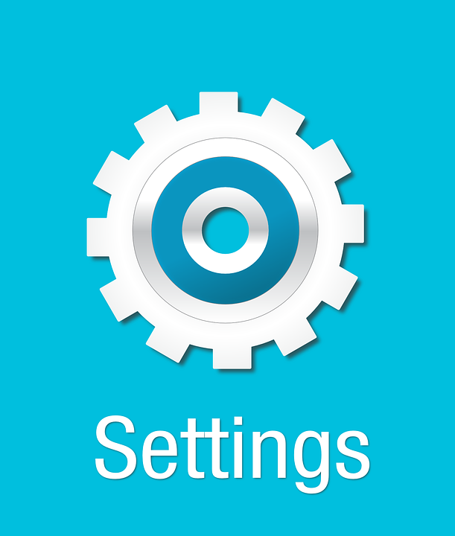
IX- WINDOWS SETTINGS
Windows Settings is an updated version of control panel.
In windows settings we will learn……
System
Devices
Network & Internet
Personalization
Accounts
Time & Language
Easy of access
Privacy
Update and security

Slide 16
X- SERVER MANAGER
Server Manager is one of the administrator tool to perform many tasks such as,
Add roles
Add and remove features
Local server properties
Events
Services
Analyzer
Tools menu
What we will learn…….
Everything about server manager and all the features it has to offer.

Slide 17
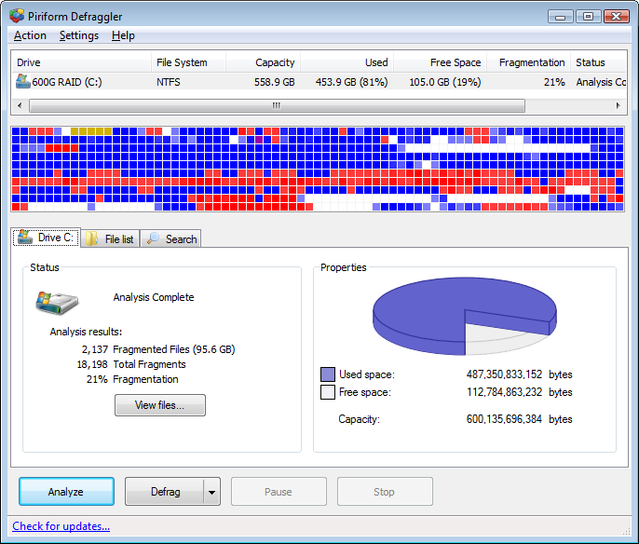
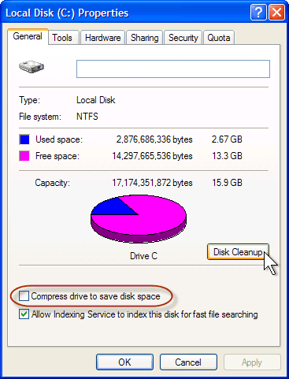
Server manager
Disk defragmentation takes all the pieces of each file, and stores them in one place. It also makes sure programs are each in one place, and that unused space on the hard disk is all together.
Disk Clean-up is a computer maintenance utility included in Microsoft Windows designed to free up disk space on a computer's hard drive.
Defragmentation
Disk cleanup

Slide 18
XI- INSTALLING AND UN-INSTALLING PROGRAMS
A system administrator has to install, update or re-install programs all the time.
Reason behind program management
Programs are needed by the users
Updates are installed when newer version is available
Un-install when a program is corrupted or no longer needed.
What we will learn….
Download a package or program
Install
Configure
Manage

Slide 19
XII- WINDOWS APPLICTATIONS
Some of the important native Windows Applications are:
Microsoft Domain Controller / Active Directory
Microsoft DNS or exchange
All the apps under accessories
Internet explorer
Microsoft office
Skype
Some 3rd party applications are:
Firefox or Google chrome
Adobe reader
Oracle VirtualBox
VMware vSphere

Slide 20
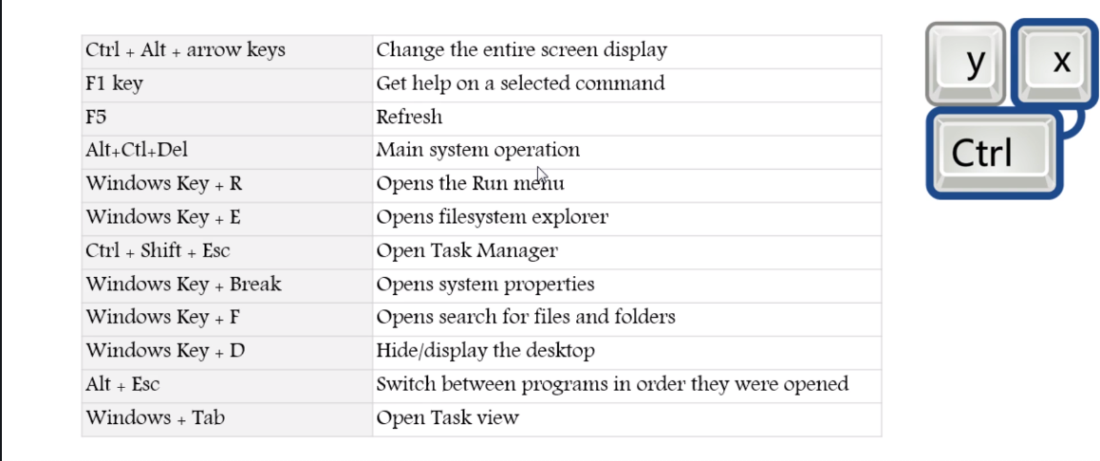
XII- Windows short-cut key

Slide 21
XIII- System Hardware (Device Manager)
Hardware is anything inside of your computer or attached to your computer.
A computer can have hardware from different manufacturer.
Knowing your hardware is important to troubleshoot issues

Slide 22
The Boot Process
Phase 1 – Preboot
In this phase, the PC’s firmware is in charge and initiates a POST and loads the firmware settings. Once all this works (hopefully), the system identifies a valid system disk and reads the MBR. The system then starts the Windows Boot Manager. This is located here: %SystemDrive%\bootmgr
Phase 2 – Windows Boot Manager This step determines if you have multiple OS installed on your computer. If yes, then it offers a menu with the names of the OSs. When you select the OS, it will load the right program, i.e., Winload.exe to boot you into the correct OS
Phase 3 – Windows Operating System Loader Like its name, WinLoad.exe loads important drivers to kick start the Windows Kernel. The kernel uses the drivers to talk to the hardware and do rest of the things required for the boot process to continue
Phase 4 – Windows NT OS Kernel : This is the last stage that picks up the Registry settings, additional drivers, etc. Once that has been read, the control is taken by the system manager process. It loads up the UI, the rest of the hardware and software. That’s when you finally get to see your Windows 10 Login screen

Slide 23
